Slide 1
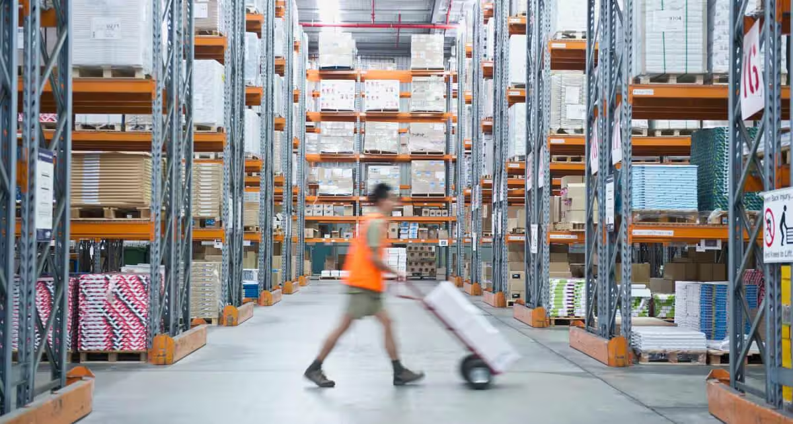
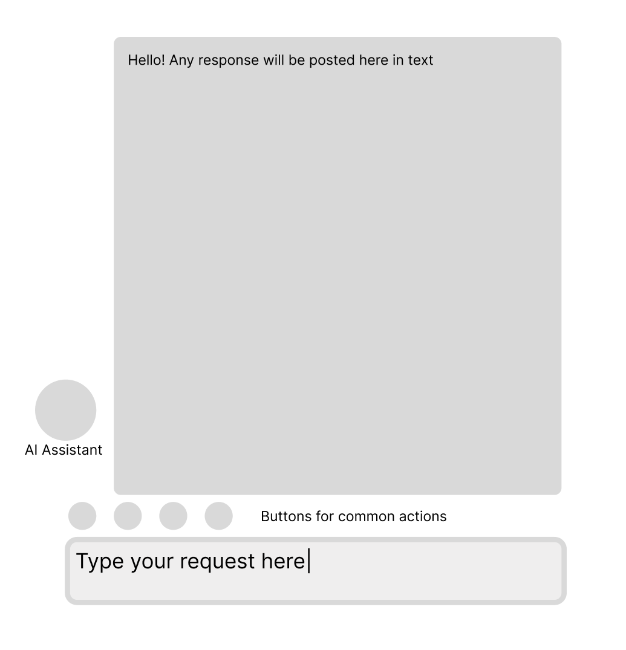
Machine Learning –
Machine learning will be used in the case of an assistant that can help the employees interact with the machines or technology in place within the centre. It will be able to help them carry out tasks and navigate throughout any forms or processes. This will provide an increase in usability for the employees, as less time will be needed to navigate the software and websites used. This will therefore increase speed within the workforce.
Another application of ML would be for estimating delivery times, where data such as location, item type and other input data. A machine learning algorithm is then used to predict how long the delivery will take. This can provide customers with a more accurate estimation of delivery.
The final application would be using machine learning to plan and predict the best delivery order, such as what routes drivers should take to maximise the efficiency of the delivery. This will increase the speed at which deliveries are made, it will also optimise the amount of time deliveries take, helping save money on drivers, fuel and vehicles/maintenance.
NLP – This will be used in conjunction with machine learning, as the assistant will need to be able to communicate clearly. This is of utmost importance as any missed information can be impactful to the centre.
Evolutionary Computation – This component can be used in systems such as predicting delivery times and calculating optimal routes for delivery. It is a good option for these tasks as improvement will be iteratively reached, eventually coming to an optimised and efficient result.
Final Assembly – The final system will be assembled either implemented directly into an already existing system, such as a program or website. It will be added on and be able to interact with the current systems to allow for things such as assisted navigation.
Ethical Considerations – There are lots of ethical consideration to consider, especially when it comes to AI. An example of this is the potential issues it can produce when it comes to incorrect answers. The answers it provides can often be assumed to be correct, causing issues when it is wrong. It also does not have the same responsibility
https://www.netsuite.com/portal/resource/articles/inventory-management/distribution-centers.shtml
User Interface – The user will be able to input requests using a text box input, where they can type the requests in. Also, buttons for repetitive tasks will be added to increase the speed at which common tasks can be executed. The information will be presented back to the user in text form, with each question giving a response along with the action being carried out if applicable. An example of how the user interface might look is shown here →
AI within a delivery distribution centre

